Slide 1

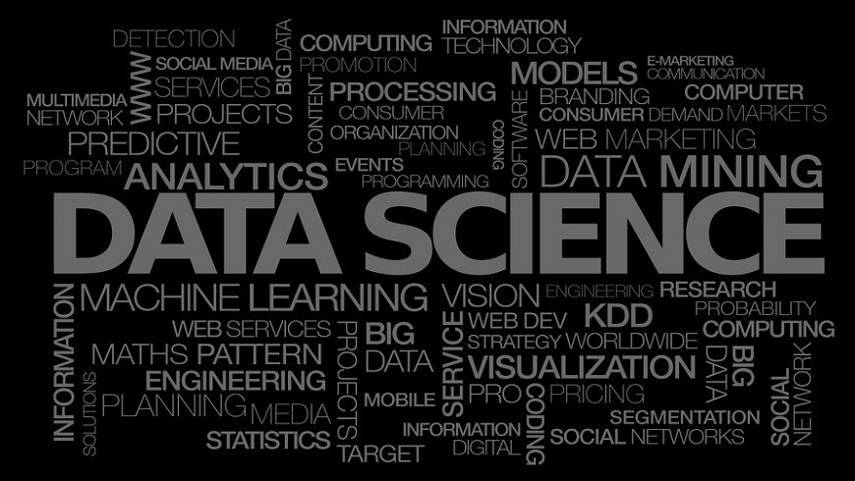
Data Science Pipeline – from Junk to Bank
Munyala Eliud & Christine Muthee
An introductory overview of Data Science applicability in Business.

Slide 2
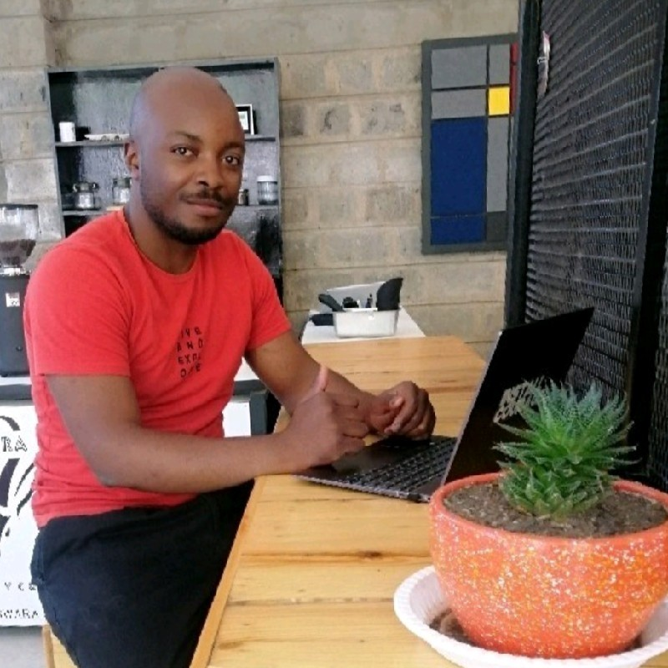
Munyala Eliud
Data Engineering and ML – Ops
F.I.T - Shop2Shop

Slide 3
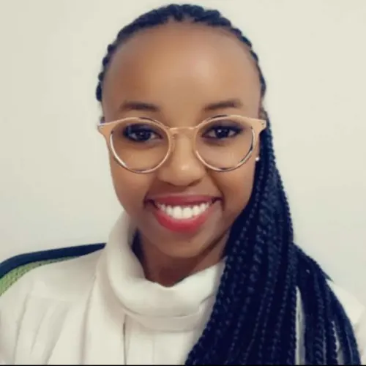
Christine Muthee
World Resources Institute
Air Quality Analyst

Slide 4
OVERVIEW
For this workshop,
Our goal is to take a basic business case idea and explore its potential for Data Science application.
We will start with a business problem or opportunity and work through the process of identifying potential data sources, developing a plan for collecting and analyzing the data, and determining the feasibility of using Data Science to solve the problem or capitalize on the opportunity.
By the end of the workshop, we should have a better understanding of the role that Data Science can play in business decision-making and be able to evaluate the potential of their own business ideas for Data Science application.

Slide 5

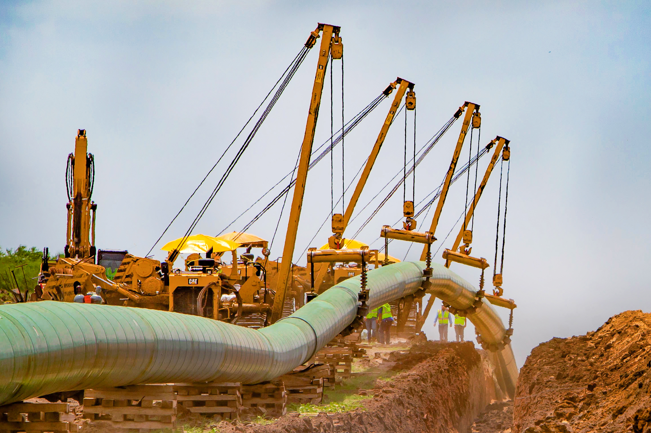

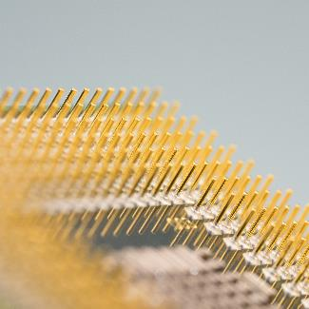
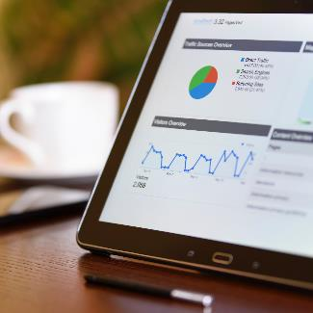
Session Overview
1. Project Overview
2. D.S Pipeline
3. Brain Storming Session
4. Code Session
5.Close Up
Review of what we will be covering on Data Science and Machine Learning
Overview of the D.S pipeline and how M.L fits in the process.
Brain storm on how this project can be done
Group works and Q&A
Practical Session of the project on Google Collab and Live Model Test
Q&A
11:30 AM - 1:00 PM
2:00 PM - 3:00 PM

Slide 6
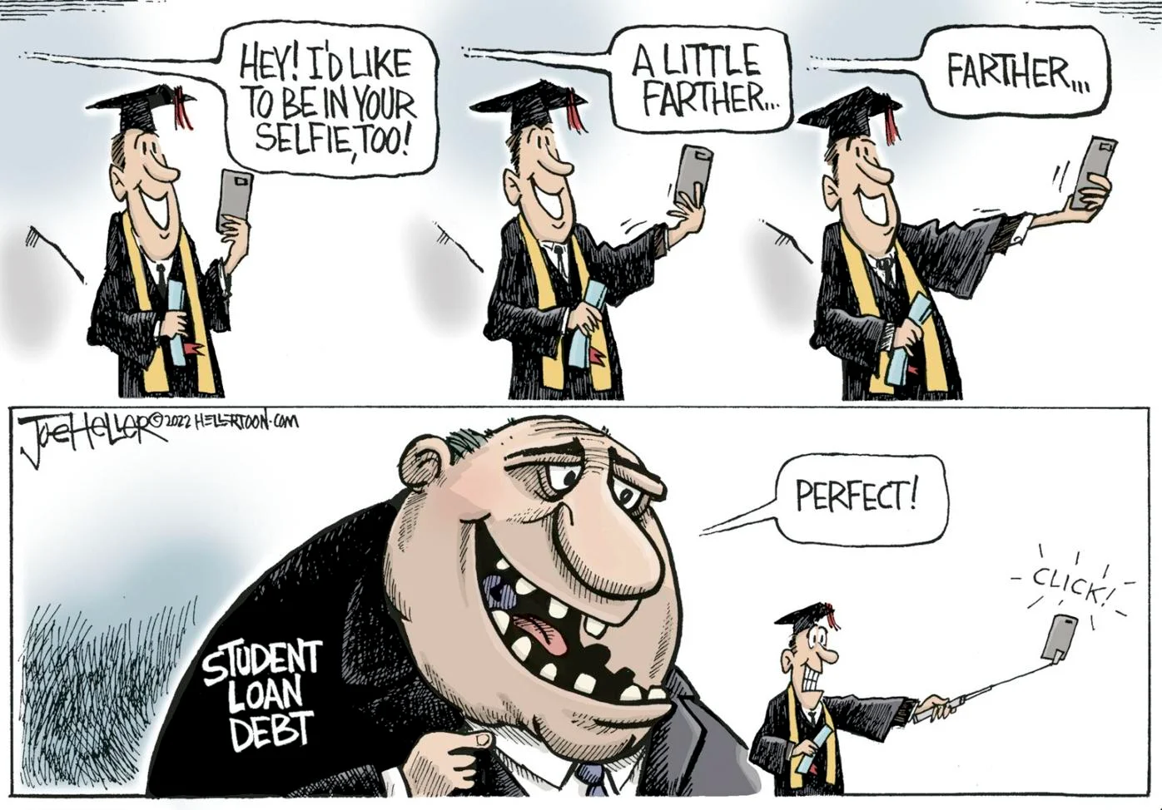
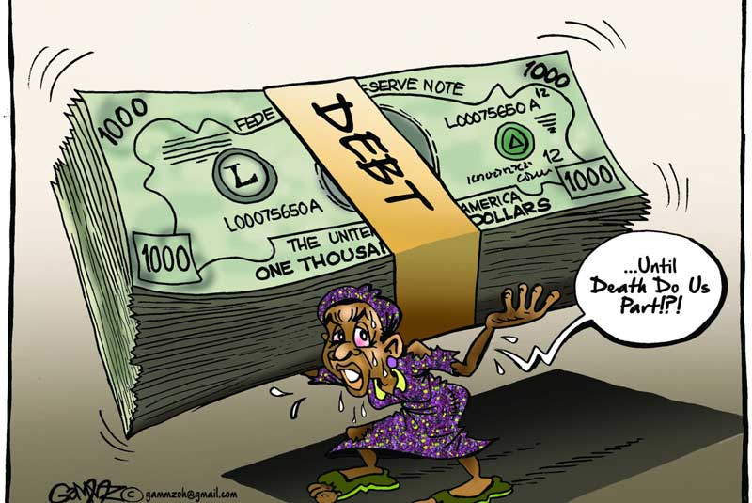
1. PROJECT OVERVIEW
Predicting Possible Loan Default Using Machine Learning
The goal of this workshop is to use machine learning techniques to predict loan default. We will begin by discussing the basics of machine learning, including key concepts and algorithms.
Then, we will explore how to use these techniques to build a model that can predict whether or not a borrower will default on their loan.
Throughout the workshop, we will work with real-world data to gain hands-on experience with these techniques. By the end of the workshop, you will have a working model that can predict loan default and a better understanding of how machine learning can be applied to this problem.

Slide 7
The Data Science Pipeline

Slide 8
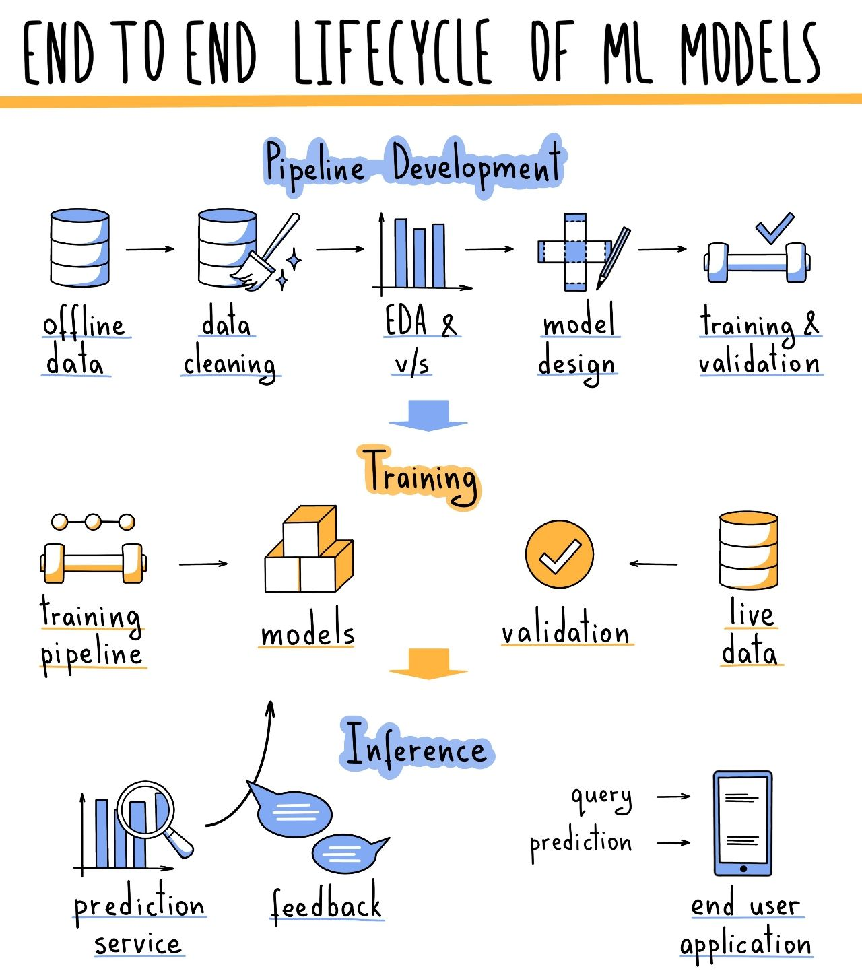

Slide 9
Group Session
What are some ways we can collect data
1 In General for any scenario i.e. Sensors, Survey, Research for a business
1.2 Problem specific i.e. Bank customer
What would be some various factors that can affect a person's likelihood of defaulting on a loan.
Ideate on some key predictors of loan default and develop a reliable method for predicting it.

Slide 10

CODE SESSION
Notebook Link

Slide 11
Thank You

Slide 12
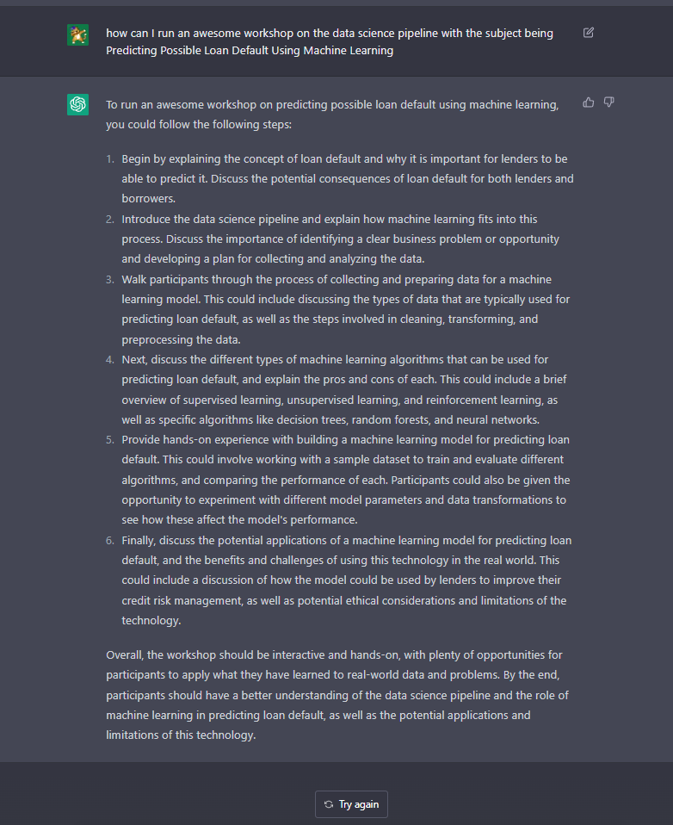
😲 Surprise This session was ideated by an AI

